Slide 1

Unmasking the Cosmos
Identifying the unknown

Slide 2
Rust-based AI
Manually cleaned up CSV data from Kepler Objects of Interest, K2, and TESS data sets
Decided on simpler ML algorithms over deep learning methods
Attempted to implement our own box-fitting least squares algorithm in Rust; still very much WIP

Slide 3
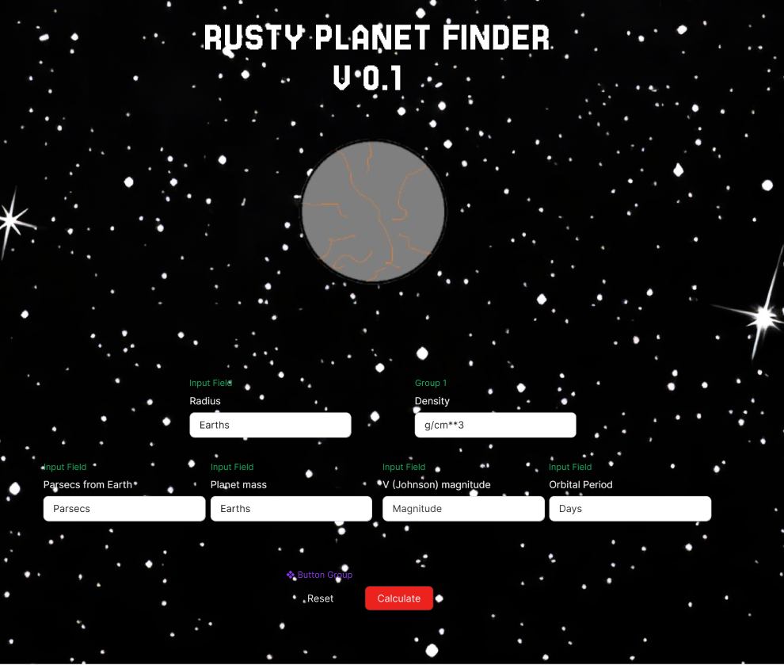
The GUI
On the right, you can see the GUI in its full glory.
On the actual website, you will be unable to see that text above some of the elements.
To find if your celestial body is an exoplanet, simply fill out the input boxes, then click “calculate”.
Yes, it is that simple!

Slide 4
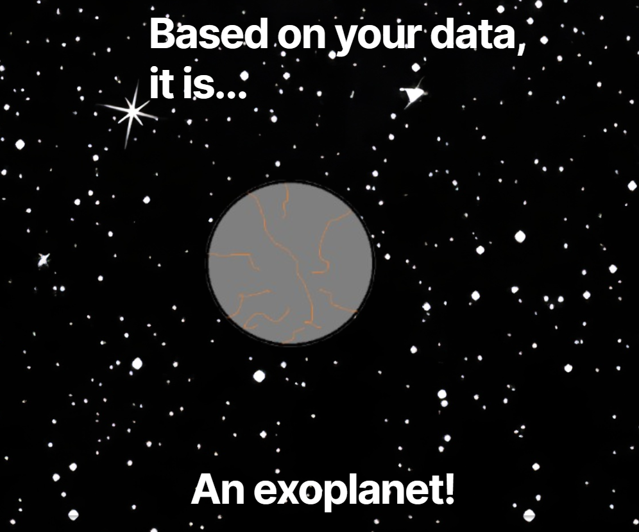

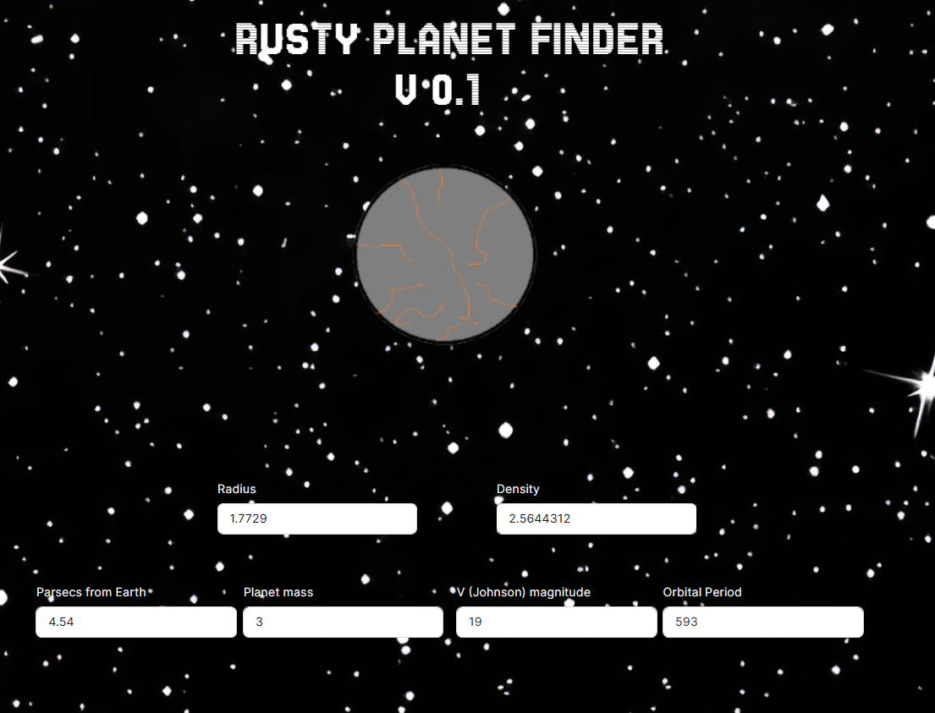
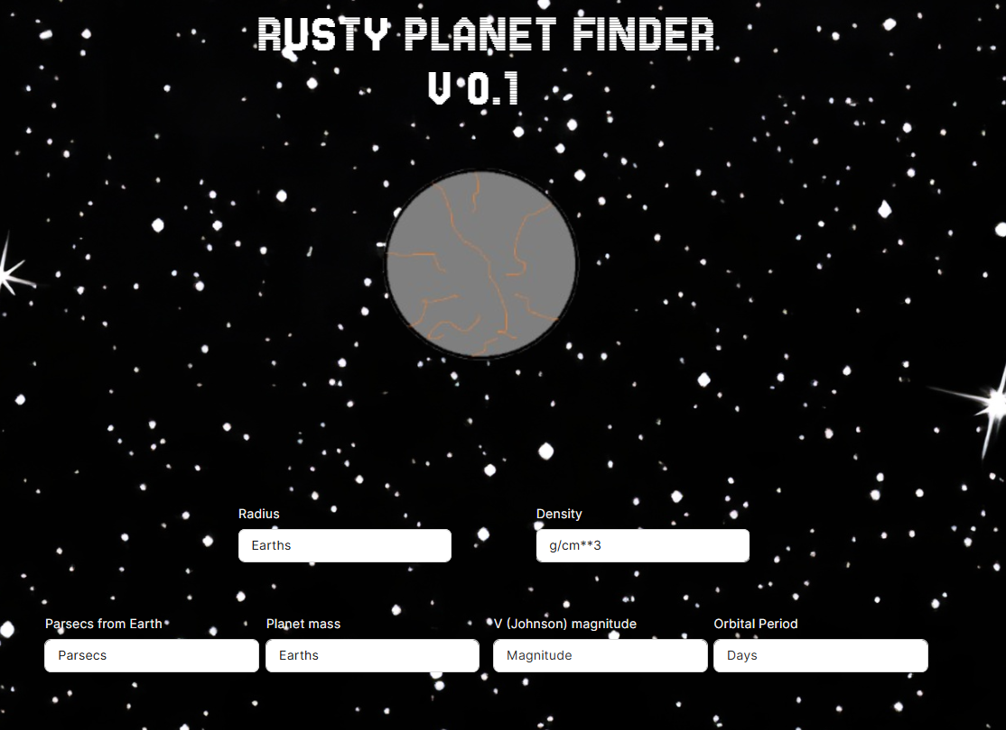

Slide 5

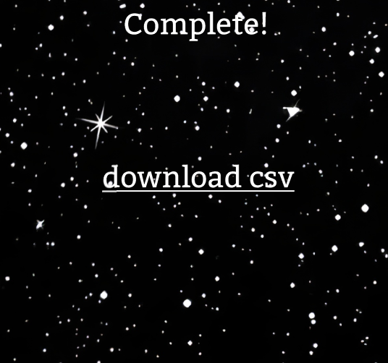
Bulk Uploading
In order to speed up the identifying process, we added a feature that allows the scanning of an entire file.
All you need to do is hit the “Upload CSV” button, select your file, and let the program work its magic until you see the “complete” screen.
Then, all you need to do is hit the “download csv” button to receive a .csv list, saying each body’s name and their exoplanet status.

